Slide 1



Doctoral training program
Alexandra Cormier, AWC at CentraleSupélec
Bernard Yannou, Deputy Director of valorization at GS SIS
Oualid Jouini, Head of doctoral training at GS SIS
Journée Accueil Doctorants GS SIS, January 15th 2024

Slide 2
Sources
Complementary doctoral trainings and activities
Seminars and thematic schools
Out of catalog
Advizing of projects and internships
Involvement in associations
Involvement for academic democracy
Organization of scientific events
Mission of teaching, expertise or valorization
Catalog ADUM
Maison du Doctorat
Graduate School
Doctoral School
Trainings in other institutions
Master courses
Alliance EUGLOH
…

Slide 3
Sources
Complementary doctoral trainings and activities
Seminars and thematic schools
Out of catalog
Advizing of projects and internships
Involvement in associations
Involvement for academic democracy
Organization of scientific events
Mission of teaching, expertise or valorization
Catalog ADUM
GS SIS
- Artificial intelligence
Entrepreneurship
English courses
Doctoral School
Trainings in other institutions
Master courses
Alliance EUGLOH
…

Slide 4
Doctoral training GS SIS
Generalize the trainings offered by each ED that are interesting to all Ph.D students of the GS
Maison du doctorat (MdD)
Implementation and monitoring the doctoral policy that is common to all Paris-Saclay
Graduate School
(GS SIS)
For engineering: Policy "master-Ph.D"; Teaching and training; Alumni Networks; Promotion
of the Ph.D for companies
Doctoral Schools: EOBE, INTERFACES, SMEMAG, STIC
Individual support and follow-up for Ph.D students
Complete and refine the MdD trainings by adapting them to the scientific fields of engineering

Slide 5
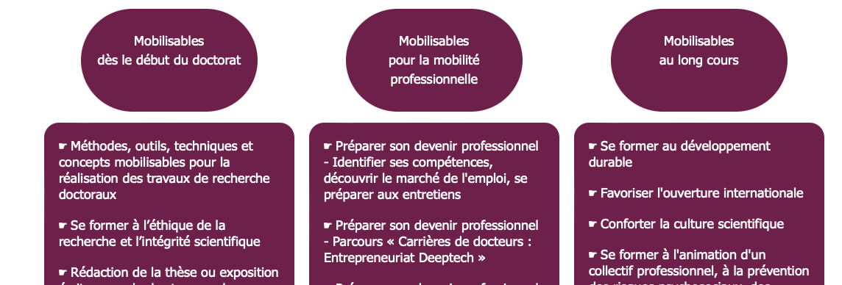
Training catalog GS SIS
4 themes
22 elective courses
+300 hours
A. culture and societal challenges
Climate workshop & Engineering sustainability
B. professional skills
Academia
R&D in companies
C. Inter-disciplinary
D. Communication & Languages
Eco-design of complex systems
Décomposition modale pour l'analyse de données
Writing skills in science
Research integrity and ethics & STIC
Entrepreneurship
Understanding the mecanisms of machine learning
Science talk
FLE, French course
Défi 6 minutes
Mieux communiquer pour présenter sa recherche
L'incertain et la complexité avec un regard SHS
GS events: The welcome dayl, The after Ph.D event
Track of courses on AI (SaclAI School)
Registration on ADUM: https://www.adum.fr/psaclay/formations
Training catalog GS SIS

Slide 6
Catalog of SaclAI School on Artificial intelligence
Registration on ADUM: https://www.adum.fr/psaclay/formations
Training catalog AI

Slide 7

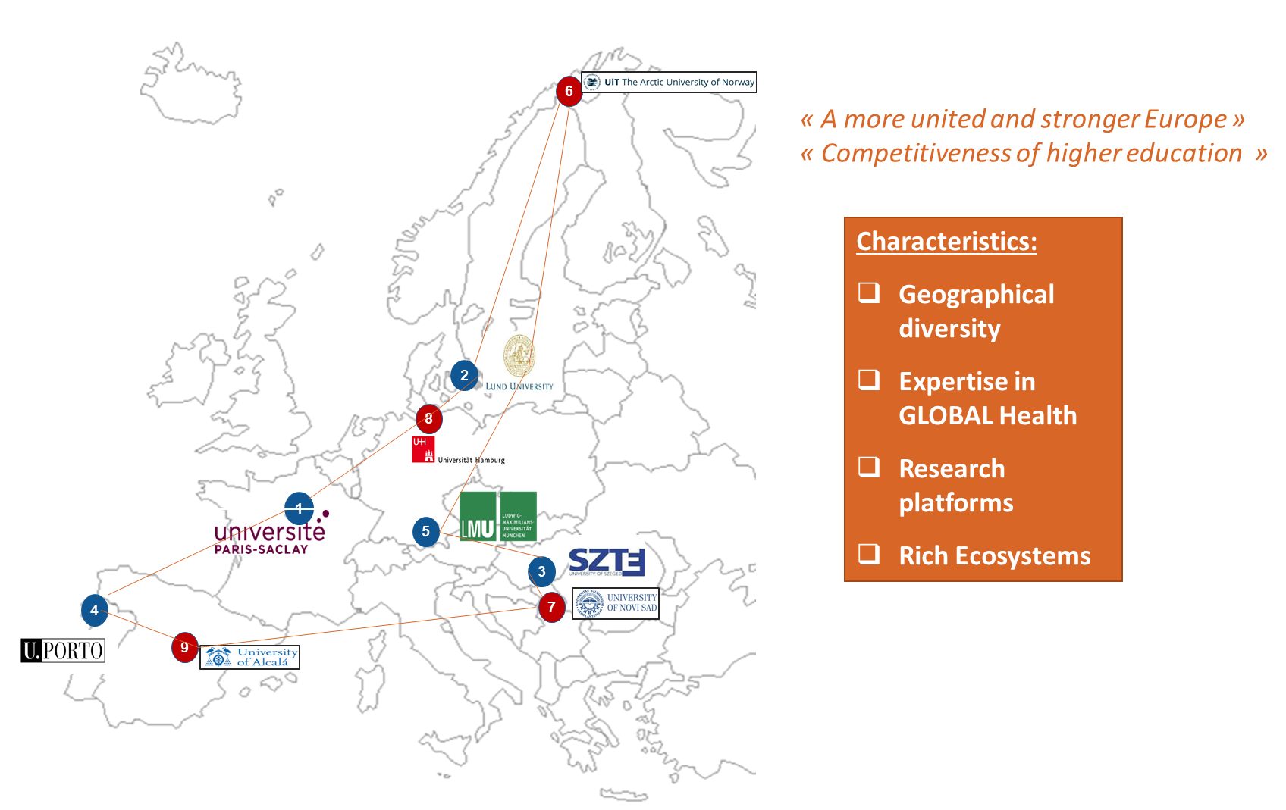
Opportunities for doctoral candidates offered by the EUGLOH European Alliance
https://www.eugloh.eu/
https://www.eugloh.eu/study-and-mobility/events
eugloh.upsaclay@universite-paris-saclay.fr
Coordination : UPSaclay
ACCESS TO THE ALLIANCE TRAININGS:
Through the ADUM catalogue or through https://www.eugloh.eu/study-and-mobility/event-calendar (in case of a direct access, you have to send an e-mail to your Doctoral School and provide the program; after the Doctoral School agreement, you will proceed to your registration)

